Slide 1
Business Intelligence G. Mudare
Notes:
Introduce yourself to the students and also find out there names
Have them give you in 30 seconds a summary of who they are and what there interest in IT is

Slide 2
Loading from multiple sources

Slide 3
Loading from multiple sources
Idea is to be able to integrate into the same table both the data, which came from excel and CSV file
The excel file containing the data cannot be gathered from the csv file,
To solve this problem Power BI Desktop model contains an internal query, created by Power BI Desktop, for each dataset.
This internal query is not visible if you perform basic operations, such as loading data from an Excel file or from a SQL Server database.
The query language (“M” ) of Power BI Desktop is used by Query Editor

Slide 4
Query Editor
To modify a Query Editor script, on the Power BI Desktop ribbon, on the Home tab, click Edit Queries,
Query Editor opens in
a new window,
presenting
many options

Slide 5
Loading from multiple sources

Slide 6
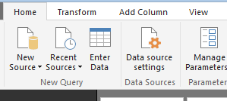
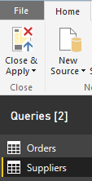
Quick tour of the Query Editor
Along the top is the ribbon, which has four tabs:
Home
Transform
Add Column
View.
Below the ribbon, on the left side, is the
Query pane, which displays a list of all the queries
for the model.
The middle pane shows the result of the query.
The Query Settings pane on the right displays the
query properties.

Slide 7
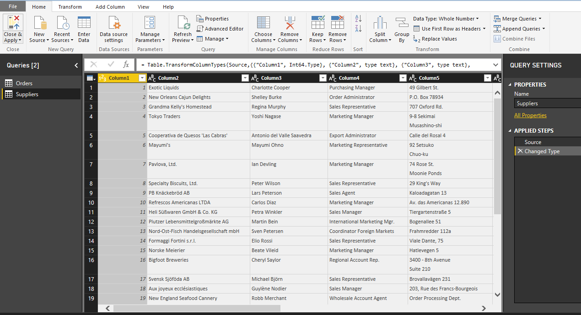
Loading from multiple sources

Slide 8
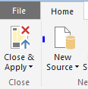
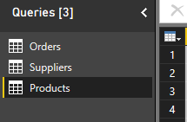
Loading from multiple sources
The objective is to create a new suppliers query that also retrieves the Orders information from the Excel workbook.
To load data from a new dataset, on the ribbon, in the New Query group of the Home tab, click New Source,
Specify to load the data from the Products table
This results in 3 tables
in the Queries pane
on the left side of the
Query Editor window

Slide 9
Quick tour of the Query Editor
When you are finished editing, on the ribbon, on the Home tab, click Close & Apply to load the data into Power BI Desktop.
When this is done, the Power BI Desktop Fields pane shows the Three sources: the two table in Excel, and the CSV file

Slide 10
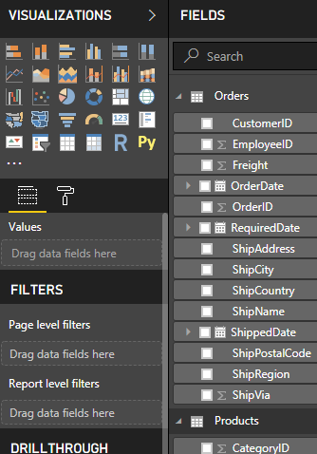
Quick tour of the Query Editor
The Fields pane lists
all of the tables (and columns) that the
Power BI Desktop
model is using.

Slide 11

Using Query Editor
At this point, you can build a report containing both the Suppliers and Products or all tables sliced by the supplierID and OrderID columns,
The chart becomes confusing, at the very least if you do not establish relationships
The values shown in your presentation appear the same unless you manage relationships
The important point here
is that you cannot slice numbers coming from
two tables using columns from only one of them,
unless the two tables share some kind of
relationship.

Slide 12

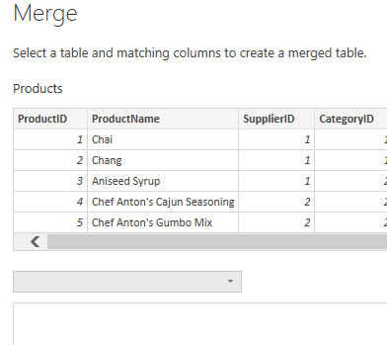
Using Query Editor
Go back to the Power BI Desktop Query Editor window and selects the query and then,on the ribbon, on the Home tab, clicks Merge Queries
Click Merge Queries to join multiple
queries into a single one.

Slide 13
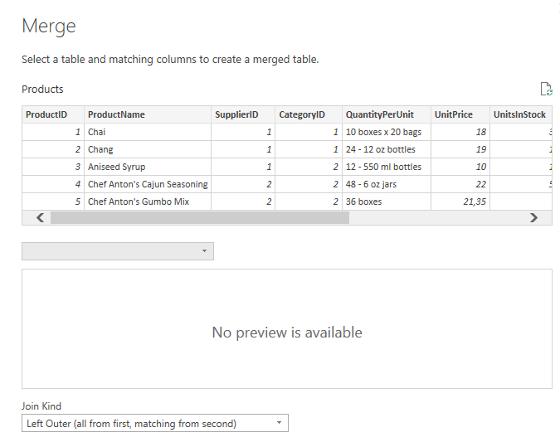
Using Query Editor
In the Merge dialog box,
you can select
which columns to use
when merging two tables.

Slide 14
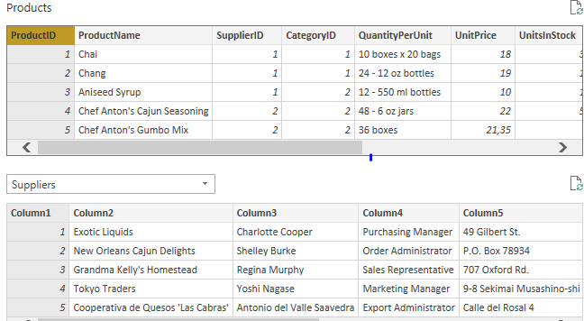
Using Query Editor

Slide 15
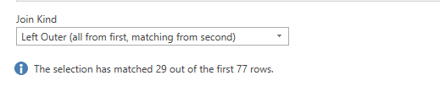
Using Query Editor
The last option available in the Merge dialog box is Join Kind.
You use this to choose what happens with rows in one table that have no corresponding rows in the other table

Slide 16

Using Query Editor
After you click OK, the table shows a new column named Suppliers, whose content is from a table,

Slide 17

Using Query Editor
When you merge two tables, the result is the original column, plus a new column of type Table.
This new column contains all of the rows that are related with the current row in the original table
If you want only the supplierID column. expand the Supplier table so that it includes only the columns you want
You can do this easily by clicking the two arrows adjacent to the column name, in the yellow box around the column.
This opens the expand column dialog box,

Slide 18
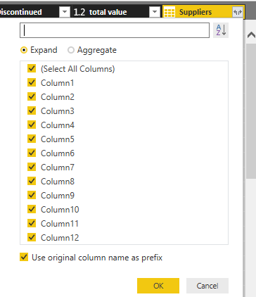
Using Query Editor

Slide 19
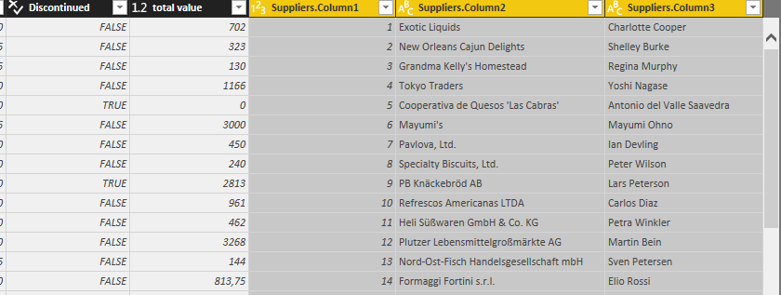
Using Query Editor
The result of this is that instead of suppliers, you now have the columns from the table for each row of the products table

Slide 20
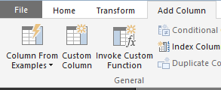
Using Query Editor
In Excel, you can transform a column by concatenating; hence, you are doing the same here.
To perform this, on the ribbon, on the Add
Column tab, click Add Custom Column (inthe General group) to create a new column containing the value of concatenates field
You can add new calculated columns to your query by using custom columns in Query Editor.

Slide 21
Using Query Editor
Before saving the query, you need to perform
a final step: that defines the data type of the column.
By default, custom columns are of the Any data type, meaning that the data type is not defined.
If you want to use it to aggregate values (which are, numbers), you must change the data type to Decimal Number

Slide 22
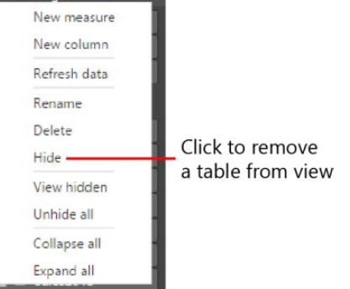
Hiding or removing tables
To hide a table, in the Fields pane, right-click the table name and then, on the shortcut menu that opens, click Hide
A hidden table, as its name implies, is no longer visible in the Fields pane. You can always make it visible again by choosing View Hidden from the context menu of any table of the field pane and then clearing the Hide check mark

Slide 23
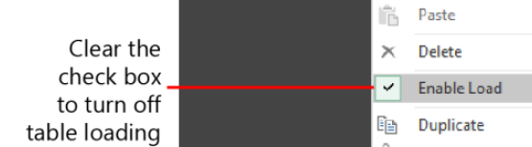
Using Query Editor
To avoid loading a table, in Query Editor, in the Queries pane, right-click the query that you want to remove and then, on the shortcut menu, clear the check mark beside Enable Load

Slide 24
Using Query Editor
To avoid loading a table, in Query Editor, in the Queries pane, right-click the query that you want to remove and then, on the shortcut menu, clear the check mark beside Enable Load

Slide 25
Using Query Editor
When you turn off loading for a table, Query Editor warns you with the message

Slide 26
Handling seasonality and sorting months
Using the Enter Data functionality, you can type or paste new datasets.
To do this, on the click Enter Data Query Editor ribbon, on the Home tab, in the New Query group,, and Query Editor shows you a grid in the Create Table dialog box, in which you can type (or paste) the data you want to add to the model.
The next step, after saving and renaming the table as Month Numbers, is to bring the Month Number column from this table into your data
Create relationship based on the month name and invoke the Merge dialog
You can then sort month names by numbers by using the Sort By Column feature.
Note It is a good practice to hide the column that you use to sort another visible column.

Slide 27
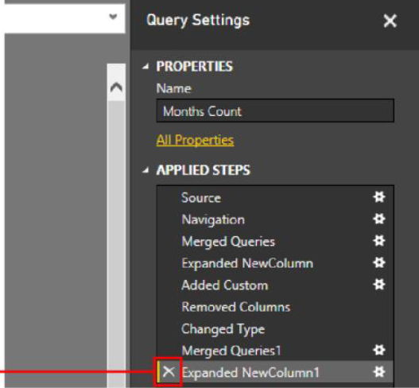
Handling seasonality and sorting months

Slide 28
Using Query Editor
If you notice that the first row containing null value right-clicks the value to open its shortcut menu, where you choose Number Filters or Text filters and then Does Not Equal, meaning that you want to filter only the rows for which are not null,

Slide 29
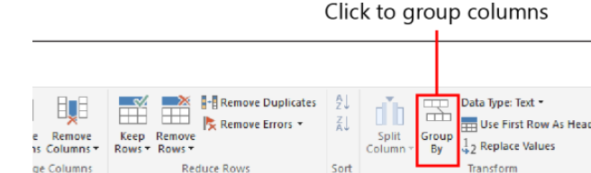
Using Query Editor
Group the current dataset by given column, then aggregate, for each combination, the number of months.
Because this is a very common operation on datasets, Query Editor offers a specific functionality: first select the columns to group by, and then choose Group By
First, select the columns to group by,
and then click Group By to open the Group By dialog
box.

Slide 30

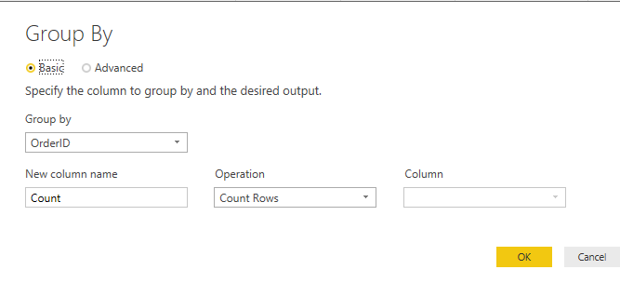

Slide 31
Using Query Editor
Navigating through the Applied Steps area of the Query Settings pane, you can view partial results of the final query.
Note When you insert a step into a query, Query Editor warns you about possible issues with the query.
When You need to add a few steps before the Added Custom step
choose an operation from the toolbar & the step is added right after the currently selected one.

Slide 32
Using Query Editor
Power BI Desktop, which is a desktop application that brings the full strength of Power BI to your PC.

Slide 33
features:
Power BI Desktop can load data from any database.
Using Power BI Desktop, you can load data from multiple sources
Power BI Desktop uses Query Editor to load data. Query Editor offers many powerful features.
Some queries are loaded into the model; others are useful only to compute values in the main query.
You can mark queries that should not go into the model as “do not load” so that they are used only in Query Editor.
Query Editor offers you a lot of power to build your models.

